Slide 1
Software Engineering
(CSE-415)
Project Scheduling

Slide 2
Project Scheduling
Scheduling is the culmination of a planning
activity that is a primary component of software
project management.
When combined with estimation methods and
Risk analysis, scheduling establishes a road map
for the project manager.

Slide 3
Project Scheduling
One of the most difficult jobs for a project manager.
Begins with process decomposition. It involves separating total work involved in a project into separate activities and judging the time required to complete these activities.
Managers estimate time and resources required to complete activities and organize them into a coherent sequence.

Slide 4
Project Scheduling
When estimating schedules, you should NOT assume that every stage of the project will be problem-free.
  People may fall ill or may leave
  Hardware may break down
  Essential software/hardware may be delivered late
If the project is new & technically advanced, Then certain parts of it may turn out to be more difficult and take longer than originally anticipated.

Slide 5
Project Scheduling: Why is it important?
Today’s software systems are large, sophisticated and complex
  Many software engineering tasks occur in parallel
  Result of work performed during one task may have a profound effect on work conducted in another task.
  Task interdependencies are very difficult to understand without a schedule
  It is virtually impossible to assess progress on a large software project without a detailed schedule

Slide 6
Why Are Software Projects Late?
There are many reasons why software is delivered late…
  An unrealistic deadline established by someone outside the software development group
  Changing customer requirements that are not reflected in schedule changes
  Risks not considered at the beginning of the project
  Miscommunications among project staff resulting in re-work & delay
  Honest under-estimation of the job

Slide 7
Why Are Software Projects Late?
Technical difficulties that could not have been foreseen in advance
Human difficulties that could not have been foreseen in advance
Project Management fails to track progress –
  Unaware the project is in behind the schedule & in trouble
  No corrective actions taken

Slide 8
What to do when face an Unrealistic Deadline?
Perform a detailed estimate of effort and time using historical data
Using an incremental process model, develop a strategy to deliver critical functionality by the deadline – document the plan
Meet with the customer and explain why the project is late
Offer the incremental development strategy as an alternative

Slide 9
Software Project Scheduling:
The Basic Principles
Compartmentalization—Compartmentalize the project into a number of manageable activities, actions & tasks
Interdependency—Indicate task interrelationship
Time allocation- Each task must be allocated some no. of work units with start date & completion date
Effort validation—be sure resources are available
Defined responsibilities—Every task should be assigned to a specific team member
Defined outcomes—Each task must have an output (e.g. work product)
Defined milestones—Task(s) should be associated with a project milestone (A milestone is accomplished when one or more work products has be reviewed for quality and approved)

Slide 10
The relationship between People and Effort
“If we fall behind schedule, we can always add more
programmers and catch up later in the project!”
Why does this not work?
  Added/new people must learn the system & learning takes time
  Teaching takes time away from productive work
  # of communication paths & Complexity of communication increase

Slide 11
The relationship between People and Effort
Over the years, empirical data & theoretical analysis have demonstrated that project schedules are elastic
  It is possible to compress a desired project completion date by adding additional resources to some extent
  It is also possible to extend a completion date by reducing the # of resources
The Putnam-Norden-Rayleigh (PNR) Curve provides an indication of the relationship between effort applied and delivery time for a software project.

Slide 12
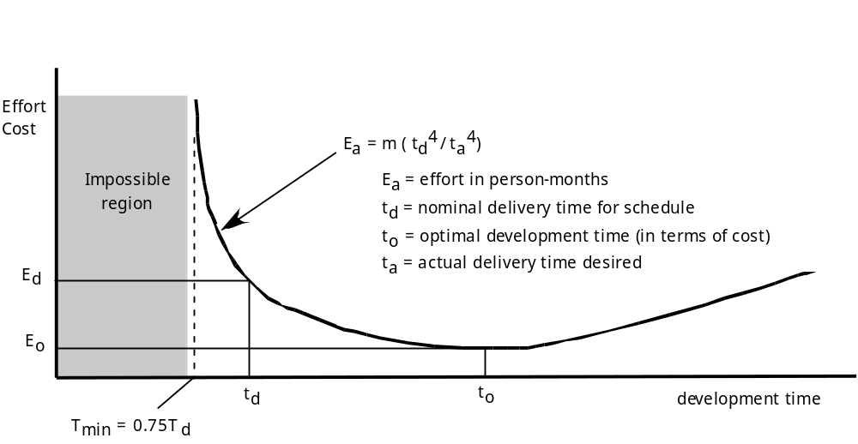
Relation between effort & delivery time: The PNR Curve

Slide 13
Project Effort Distribution
How should effort be distributed across the software process workflow?
A recommended distribution of effort across the software process is often referred to as the 40-20-40 rule
  40% of effort ==> “Front-end” (analysis & design)
  20% of effort ==> Coding
  40% of effort ==> “Back-end” (testing)

Slide 14
Project Effort Distribution
Generally accepted guidelines :
  02-03 % ==> Project Planning
  10-25 % ==> Requirements analysis
  20-25 % ==> Design
  15-20 % ==> Coding
  30-40 % ==> Testing and debugging

Slide 15
Defining Task Sets for Software Project
Determine type of project
  Concept development, New application development, Application enhancement, Application maintenance, and Reengineering projects
Assess the degree of rigor required
Identify adaptation criteria
Select appropriate software engineering tasks ( Concept Definition, Project Planning, Risk Analysis, Implementation, Integrate and Test, Demonstrate)
Define Entrance and Exit Criteria
Define Progress Metrics
Assign Responsibilities
Allocate milestones

Slide 16
Define a Task Network
A Task Network ( AKA Activity Network) is a graphic representation of the task flow for a project.
A task network depicts each software engineering task, its dependency on other tasks, and its projected duration.
  The task network is used to compute the critical path, a timeline chart and a variety of project information
  The task network is a useful mechanism for depicting intertask dependencies & determining the critical path.

Slide 17
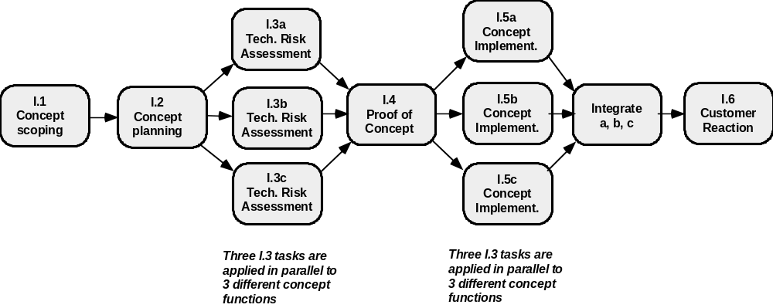
Define a Task Network
Fig. A Task Network for concept development

Slide 18
Scheduling Methods
Two project scheduling methods can be applied to software development-
  PERT-Program Evaluation and Review Technique
  CPM- Critical Path Method
Both techniques are driven by information already developed in earlier project planning activities –
  Estimates of effort
  A decomposition of product function
  Selection of appropriate process and task set
  Decomposition of task

Slide 19
Scheduling Methods
Both PERT & CPM provide quantitative tools that allows software planner to –
  Determine critical path –the chain of tasks that determines project-duration
  Establish “most likely” time schedules for individual tasks (using statistical model)
  Calculate “boundary times”

Slide 20
Timeline Charts
When creating a s/w project schedule, the planner begins with a set of tasks (The work breakdown structure). If automated tools are used, work breakdown is input as a task network. As a consequence, a timeline chart is generated.
A timeline chart (also called Gantt chart) can be developed for the entire project. Also, separate charts can be developed for each project function.
A timeline chart enables you to determine what works will be conducted at a given point in time.

Slide 21
Timeline Charts
Tasks
Week 1
Week 2
Week 3
Week 4
Week n
Task 1
Task 2
Task 3
Task 4
Task 5
Task 6
Task 7
Task 8
Task 9
Task 10
Task 11
Task 12

Slide 22
Tracking the schedule
Project schedule provides a road map for a software project manager. Project schedule defines the tasks & milestones that must be tracked & controlled as the project proceeds.
Schedule Tracking techniques used by Experienced Project Managers:
  Conducting periodic project status meeting in which each team member reports progress & problems
  Evaluating the results of all reviews
  Determining whether formal milestones have been accomplished by the scheduled date
  Compare actual start-date with scheduled start-date
  Informal meeting with practitioners
  Using earned value analysis to assess progress quantitatively.

Slide 23
Tracking the schedule
Control is employed by a project manager to administer project resources, cope with problems, and direct project staff
If things are going on well, control is light.
If problems occur, project manager must exercise control to reconcile them as quickly as possible.
  Diagnose the problem
  Additional resources may be focused on the problem area
    Staff may be redeployed
    Project schedule can be redefined

Slide 24
Tracking the schedule
What is the indication of progress?
  The best indication of progress is the completion & successful review of a defined software work product.

Slide 25
Earned Value Analysis (EVA)
Earned value –
  is a measure of progress
  provides a quantitative indication of progress
  enables us to assess the “percent of completeness” of a project using quantitative analysis
Earned Value Analysis (EVA) is a quantitative technique for assessing progress.
  The total hours to complete the entire project are estimated and each task is given an earned value based on its estimated percentage contribution to the total.

Slide 26
Computing Earned Value
The budgeted cost of work scheduled (BCWS) is determined for each work task represented in the schedule.
  BCWS_{i} is the effort planned for work task i.
The BCWS values for all work tasks are summed to derive the budget at completion, BAC. Hence,
BAC = ∑ (BCWS_{k}) for all tasks k

Slide 27
Computing Earned Value
Next, the value for budgeted cost of work performed (BCWP) is computed.
  The value for BCWP is the sum of the BCWS values for all work tasks that have actually been completed by a point in time on the project schedule.
“The distinction between the BCWS and the BCWP is that the former represents the budget of the activities that were planned to be completed and the latter represents the budget of the activities that actually were completed.”
Given values for BCWS, BAC, and BCWP, important progress indicators can be computed:
    Schedule Performance Index, SPI = BCWP/BCWS
    Schedule Variance, SV = BCWP – BCWS
    SPI is an indication of the efficiency with which the project is utilizing scheduled resources.

Slide 28
Computing Earned Value
Percent scheduled for completion = BCWS/BAC
  provides an indication of the percentage of work that should have been completed by time t.
Percent complete = BCWP/BAC
  provides a quantitative indication of the percent of completeness of the project at a given point in time, t.
Actual cost of work performed, ACWP, is the sum of the effort actually expended on work tasks that have been completed by a point in time on the project schedule. It is then possible to compute
    Cost performance index, CPI = BCWP/ACWP
    Cost variance, CV = BCWP – ACWP

Slide 29
Scheduling and Tracking:Where Are We?
Using the schedule as a guide , the project manager can track and control each step in the software process.

